Slide 1
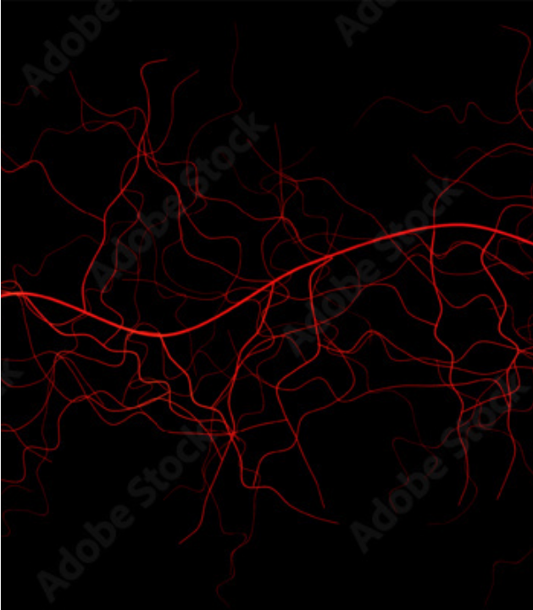
ATLAS ALIGNED
SECURITY ASSESSMENT
AI Red Team Assessment Project
Attack · Detect · Defend
A local operation against a containerized image classifier
Kirubel M. Sahle
2026

Slide 2
THREAT LANDSCAPE
Why AI Red Teaming Matters
3,000+
$4.4B
Days
AI incidents recorded in the AI Incident Database since 2019
Cost of a single 2023 enterprise AI breach
Attack window for an unprotected inference endpoint
Bottom line: Every exposed model is a target.

Slide 3

DEFINITION
What is Red Teaming?
A structured adversarial exercise executed end-to-end.
1
Target Setup
Deploy target containerized model
Target Acquisition: Build or acquire the victim AI service.
Real Tools: Attack using identical adversary tooling.
2
Adversarial Exploitation
Evasion, extraction, & pipeline attacks
Proof of Impact: Document findings with concrete measurements.
Defensive Validation: Propose and verify hardened controls.
3
Remediation & Verification
Hardened endpoint & active rules
Not a checklist audit. Not a compliance review.

Slide 4
PARADIGM SHIFT
AI Red Teaming vs Traditional
TRADITIONAL SYSTEMS | AI SYSTEMS
Deterministic logic (code executes defined rules) | Probabilistic outputs (fuzzy decision surfaces)
Attack the code (buffer overflows, injection) | Attack code and weights (gradients, data)
Fixed input space (structured parameters) | Continuous high-dimensional space (vectors)
Exploits are visible bugs (crashes, leaks) | Exploits look like normal inputs (adversarial noise)
Bottom line: Code does what it says. Weights do what they learned — and those are not the same thing.

Slide 5
METHODOLOGY
The Attacker's Mindset
Threat modelling in three questions:
1. What are we protecting? → Assets
ASSETS
ADVERSARIES
CONTROLS
Weights, training data membership, inference endpoint
Network client with API access, no host access
Rate limits, validators, detector, robust model
2. Who wants it? → Adversaries
3. What stops them? → Controls
"If you can't answer all three, you don't have a threat model — you have a wish list."

Slide 6
STANDARDS
Industry Security Frameworks
ATTACK CATALOGUE
RISK MANAGEMENT
WEB / API SURFACE
MITRE ATLAS
NIST AI RMF 1.0
OWASP API Top 10
Adversarial Threat Landscape for AI. Every attack tagged with technique IDs.
Risk Management Framework. Every defense maps to a specific core function.
Web vulnerability classes for exposed REST endpoints.
AML.T0043 · AML.T0024 · AML.T0025
GOVERN · MAP · MEASURE · MANAGE
API4 (Rate Limit) · API6 · API9
ATLAS tells you what the attack is. RMF tells you what to do about it. OWASP tells you how the API is exposed.

Slide 7
TAXONOMY
Attack Taxonomy
Attacks on AI Systems
MODEL-LEVEL ATTACKS
SYSTEM-LEVEL ATTACKS
Target: Model weights & decisions
Target: Pipeline & container infrastructure
Evasion · Model Extraction · Membership Inference · Poisoning · Backdoor
Metadata leaks · Container misconfig · Credential exposure · CORS · Docs
Two different attackers, two different skill sets, two different defense strategies.

Slide 8
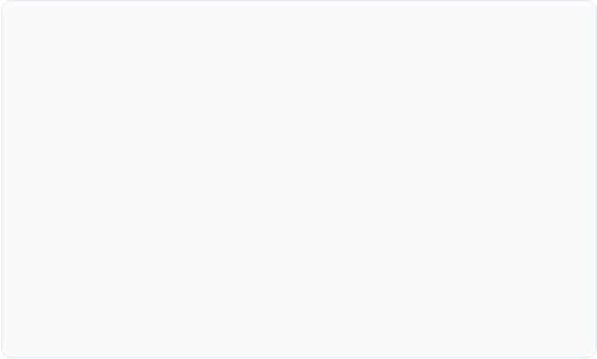

MODEL SURFACE
Model-Level Attacks
Model-level attacks target three properties:
1. DECISIONS: Make it wrong (Evasion)
2. KNOWLEDGE: Steal the architecture (Extraction)
3. MEMORIES: Leak training samples (MIA)
Each attack exploits a fundamental mathematical property of trained neural networks.

Slide 9
INFRASTRUCTURE SURFACE
System-Level Attacks
Targeting the surrounding application stack:
CONTAINER CROSS-SECTION
Metadata Leaks: Architecture, framework versions
FastAPI App Process (Root privileges)
/docs exposed
Stack traces ON
No rate limit
Credentials: API keys in environment variables
Container Config: Root privileges, volume mounts
Mounted Volumes & Environment
Plaintext API keys
Host paths exposed
Resource Controls: Rate limit gaps, memory quotas

Slide 10
SCOPE
The Implemented Model Attacks
1. Evasion
COVERED
2. Extraction
COVERED
Craft inputs that look normal to humans but fool model predictions.
Systematically query the inference API to train a duplicate substitute model.
3. Membership Inference
BONUS
Determine whether specific data samples were included in the training set.
Bottom line: Three demonstrated with empirical data. The fourth requires offline access.

Slide 11
END-TO-END OPERATION
The Attack Lifecycle
01. RECON
02. ENUMERATE
03. CRAFT
04. EXPLOIT
05. DETECT
06. NOTIFY
07. REMEDIATE
Metadata
Endpoints
Payloads
Execution
Rules
Alerting
Hardening

Slide 12
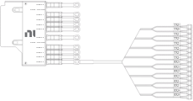
DEFENSE ARCHITECTURE
Defense Taxonomy
PREVENTIVE
CORRECTIVE
DETECTIVE
Stop at Boundary
Active Response
Real-Time Visibility
Rate limiting, input validation, API auth, adversarial model training.
IP blocklisting, key revocation, artifact quarantine, rate limit enforcement.
Log parsers, signature rules, cooldown filters, Telegram notifications.

Slide 13

PREVENTION
Preventive Controls
1. Rate Limiting
20 requests / 60 s / IP caps high-volume extraction queries.
2. Input Validation
Enforces image dimensions, color channels, and noise heuristics.
3. Authentication
Enforces mandatory x-api-key header on hardened endpoints.
4. Robust Models
Adversarial training with PGD examples raises accuracy floor.

Slide 14
RESPONSE
Corrective Controls
STEP 1: DETECT
Threshold or heuristic anomaly trigger
Response actions to detected attacks:
Blocklist: Drop traffic from offending IP addresses.
Revocation: Invalidate leaked API credentials instantly.
STEP 2: DECIDE
Quarantine: Isolate suspect model artifacts.
Evaluate rule confidence & false-positive risk
Implementation Status: Rate limiter corrects live; IP blocklist designed; key rotation documented.
STEP 3: ENFORCE
Trigger HTTP 429 / revoke token / drop socket

Slide 15
TARGET SPECIFICATION
Target Overview — At a Glance
MODEL
DATASET
SmallCNN
CIFAR-10 Subset
3 Conv Layers + 2 FC Layers
618,820 Parameters
4-class subset
Airplane · Auto · Bird · Cat
PIPELINE
HOST ENVIRONMENT
FastAPI + Docker
Local Linux
5 containers total
Vulnerable vs Hardened Modes
8 GB RAM · CPU Inference
Zero cloud dependencies

Slide 16
CODE STRUCTURE
Clean Architecture Boundary
interfaces/ FastAPI entry points, detector main, alerts API
UNTRUSTED ENTRY
adapters/ HTTP, auth, rate limiters, validators, detector rules
DELIBERATE VULNS
usecases/ serve_prediction workflow logic
services/ preprocessing, model inference, attack math
domain/ SmallCNN definition, CLASSES, core entities
Every deliberate vulnerability lives in adapters. That's where untrusted input arrives.

Slide 17
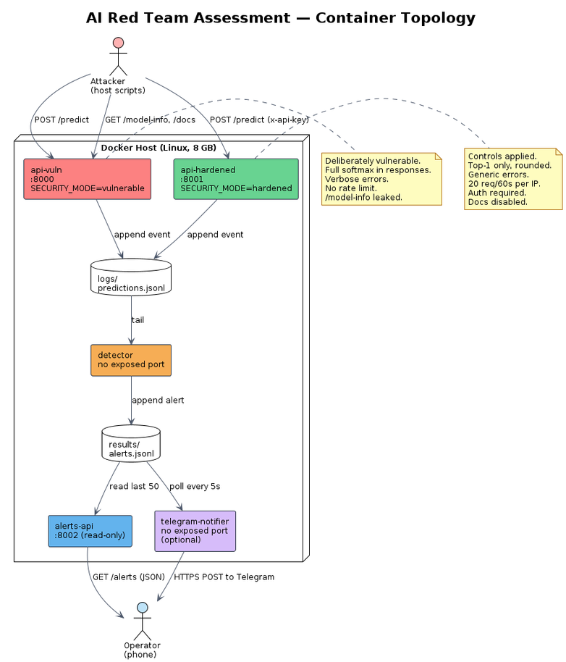
DEPLOYMENT ARCHITECTURE
Container Topology
api-vuln
Port :8000
Unrestricted inference endpoint
api-hardened
alerts-api
Port :8001
Port :8002
Hardened inference endpoint
Read-only alert viewer
telegram-notifier
READ-ONLY MOUNT
Outbound polling worker
detector
NO EXPOSED PORT
Internal background process
Only two containers expose ports. Detector has zero network exposure.

Slide 18
COMPARISON
Vulnerable vs Hardened Endpoint
VULNERABLE MODE (:8000) | HARDENED MODE (:8001)
Full softmax vector returned | Top-1 class + rounded confidence
Verbose error traces exposed | Generic error messages
No rate limiting | 20 req / 60 s / IP cap
Authentication optional | x-api-key header required
/docs auto-generated exposed | Docs disabled entirely
Container runs as root | Container runs as non-root appuser

Slide 19
ASSUMPTIONS
Adversary Capabilities & Boundaries
ADVERSARY CAN
ADVERSARY CANNOT
Submit arbitrary images to /predict
Read model weight files directly
Enumerate exposed API endpoints
Access Docker socket or host OS
Attempt key guessing & auth bypass
Modify source code or config files
Observe response timing & metadata
Inspect training dataset directly
Send thousands of automated queries

Slide 20

AI VULNERABILITIES
Why AI is Different
Three unique properties of AI models:
1. Non-Determinism
Identical prompts can yield variable output probabilities.
2. Continuous Gradients
Tiny input perturbations produce massive classification shifts.
Traditional security audits source code.
AI security audits decision boundaries.
3. Learned Behaviour
Logic resides in weights, not explicit source code conditionals.

Slide 21
ATTACK SURFACE
Attack Surface of an AI Pipeline
AI MODEL CORE
01. INPUTS
02. WEIGHTS
03. LOGS
04. METADATA
05. API
Evasion & MIA
Extraction & Theft
Tampering
Arch Leaks
Rate Limit Abuse
Every surface requires a distinct control. Weaknesses found across inputs, metadata, and API.

Slide 22
DATA VECTOR
Data as an Attack Vector
Training Data Integrity:
Influencing training data directly manipulates model decisions (Data Poisoning).
Poisoned Data
Training
Backdoored Model
Scope Note: Training pipeline was offline during testing. Data poisoning is documented as a limitation.

Slide 23
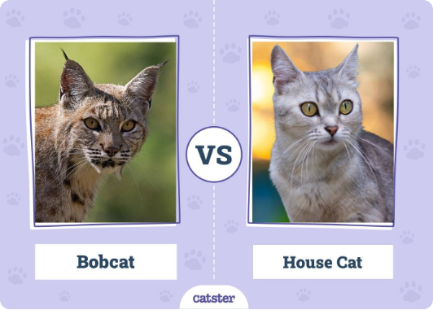
EVASION CONCEPT
Adversarial Examples — Visual Impact
Original: Cat (94%)
Adversarial: Airplane (87%)
Same pixels to a human. Completely different pixels to the model.

Slide 24
ATTACK MECHANICS
Attack 1: Evasion Algorithms
MITRE ATLAS: AML.T0043
Gradient-based perturbation algorithms compute loss gradient with respect to input pixels.
1. Compute Loss Gradient
∇_x L(θ, x, y)
FGSM (Fast Gradient Sign Method)
2. Extract Sign Direction
sign(∇_x L)
One single step along gradient sign.
3. Apply Perturbation Step
x + ε · sign(∇_x L)
PGD (Projected Gradient Descent)
Iterative step-wise optimization bounded by ε.

Slide 25
EMPIRICAL RESULTS
Attack 1: Evasion Benchmark Results
BASELINE MODEL (ε = 8/255)
ROBUST MODEL (ε = 8/255)
0.05
0.00
0.33
0.18
FGSM Accuracy
PGD Accuracy
FGSM Accuracy
PGD Accuracy
Adversarial training raised FGSM accuracy from 0.05 to 0.33. Six times higher resistance.

Slide 26
MODEL THEFT
Attack 2: Model Extraction
MITRE ATLAS: AML.T0024
Defensive Impact vs Hardened Endpoint
Query victim model 2,000 times, collect outputs, train substitute model.
Rate Limiter Action
Soft Labels (Full Softmax): Fidelity = 0.835
Extraction attempt halted after 20 of 30 queries due to HTTP 429 response enforcement.
Hard Labels (Argmax): Fidelity = 0.825
Random baseline = 0.275

Slide 27
PRIVACY LEAKAGE
Attack 3: Membership Inference (MIA)
MITRE ATLAS: AML.T0025
CONFIDENCE THRESHOLD SWEEP
Query matched samples of training members vs non-members. Compare confidence scores.
~0.55
0.50
Vulnerable Accuracy: 0.5425
Hardened Accuracy: 0.5575
Weak Memory Leakage
Random Guessing
Majority Baseline = 0.50
Signal stays near 0.50 baseline. Model does not strongly memorize training samples.

Slide 28
AUDIT FINDINGS
Nine System-Level Findings
# | FINDING DESCRIPTION | ATLAS ID | STATUS
1 | /model-info architecture leak | AML.T0007
2 | Verbose error stack traces | AML.T0007
3 | No inference rate limiting | AML.T0024
4 | Auto-generated API docs exposed | AML.T0007
5 | API key in plaintext environment | AML.T0010
6 | Container process runs as root | AML.T0000
7 | Volume mounts expose host paths | AML.T0000
8 | Uncapped container memory/CPU | —
9 | No explicit CORS restriction | AML.T0000
Vulnerable Only
Vulnerable Only
Vulnerable Only
Vulnerable Only
Mitigated
Remediated
Mitigated
Remediated
Remediated

Slide 29
REMEDIATION MATRIX
Defenses Built Across Attack Classes
01. EVASION DEFENSE
02. EXTRACTION DEFENSE
03. MIA DEFENSE
PGD Adversarial Training
Rate Limiter & Quotas
Output Precision Reducer
Noise validator + detector rule: adversarial_noise
20 req / 60s + detector rule: extraction_volume
Rounded confidence + detector: mia_confidence
PGD Acc: 0.00 → 0.18
Blocked at 20 queries
Signal near 0.50 baseline

Slide 30
ALERT OPERATIONS
Detection & Telegram Notification Performance
Key Operational Metrics
TELEGRAM ALERT PREVIEW
3 Rules: One per ATLAS technique class
[ALERT] Model Extraction Volume
60s Cooldown: Prevents alert flooding per IP
IP: 192.168.1.45
Rule: extraction_volume
Trigger: 20 req / 60s
Time: 2026-03-27 14:22:01
Alert Suppression: 50 alerts → 2 alerts under attack
Delivery Latency: Telegram delivery within 35s

Slide 31
KEY LESSONS
What I Learned
1. Attacking is Easy. Defending is Hard.
2. Adversarial Training is a Trade-Off.
FGSM took five lines of code. Adversarial training took 20 epochs and cost clean accuracy.
Robust accuracy at ε=8/255 is 0.18 for PGD. The model resists, but does not defeat.
3. Detection is Not Prevention.
4. Documentation is the Deliverable.
The detector sees the attack but doesn't block it. Rate limiters perform the enforcement.
Attacks only matter if reproducible. Every single metric in this deck is backed by results files.

Slide 32

Detection without remediation is observation.
Remediation without detection is guesswork.
This assessment does both.
github.com/piVentures/ai-redteam-project
Kirubel M. Sahle · 2026
Thanks

